Slide 1


Business Analysis of Western Financial Market Using SQL, Excel, Power BI,
Saurabh Shinde
saurabhshinde2407@gmail.com
Business Analyst Career Program chat gpt included batch - 17

Slide 2


INDEX / AGENDA
Objective
The primary objective of this capstone project is to perform a comprehensive business analysis of the Western Financial Market dataset using advanced tools such as Excel, SQL, Power BI. By analysing the data, the aim is to:
Understand the underlying trends and patterns in the financial market data of Western countries.
Clean and preprocess the data to ensure its accuracy and reliability for further analysis.
Perform statistical analysis to extract meaningful insights related to sales, profits, and other key financial metrics.
Visualize the data through interactive dashboards and graphs to aid in data-driven decision-making.
Answer critical business questions such as product-wise sales, segment-wise profits, and yearly financial performance to provide actionable insights for business improvement.
Derive conclusions and recommendations based on the analysis that can help businesses understand market dynamics and optimize their strategies.
By the end of this project, the goal is to have a comprehensive, data-driven report that not only highlights the key financial insights but also provides visual tools for easy exploration of the dataset.
Introduction to the dataset
Data Cleaning and Statistical Analysis
Graphical Analysis using Excel
SQL Data Import and Queries
Power BI Visualization and Dashboard
Key Insights and Answers to Business Questions
Conclusion & Inferences

Slide 3
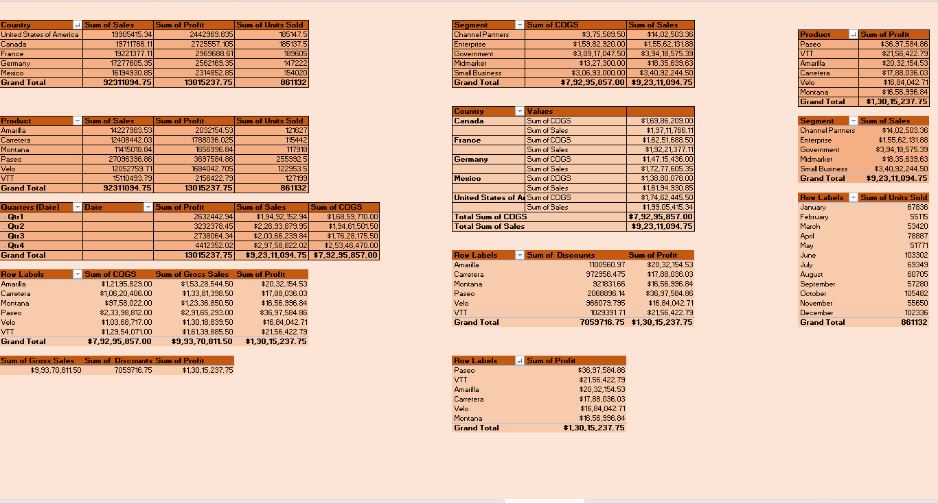
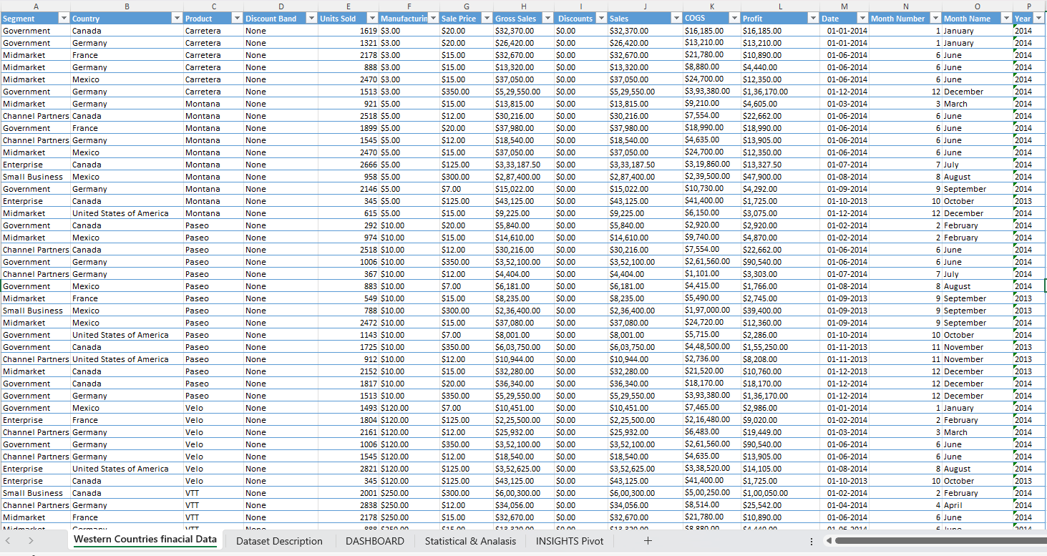

INTRODUCTION TO DATASET
The Western Countries Financial Data dataset includes detailed financial metrics for several Western countries. Key columns include:
Country: The name of the country.
Product: Products sold in various regions.
Segment: Customer segments (e.g., Corporate, Consumer).
Sales: Total sales amount.
Profit: Profit generated.
Discount: Discounts offered.
Units Sold: Number of units sold.
Order Date: Date of the transaction.
Category: Product categories (e.g., Electronics, Furniture).
This dataset allows for an in-depth exploration of sales performance, profitability, and other financial indicators.
Description : The dataset comprises transactional financial data from Western countries, segmented by product, and geographic region. The data is structured to provide a comprehensive overview of business performance, including sales, profits, and discounts. With time-series data spanning two years, the dataset facilitates temporal analysis (e.g., yearly sales and profits) and comparative analysis across countries and product categories.

Slide 4

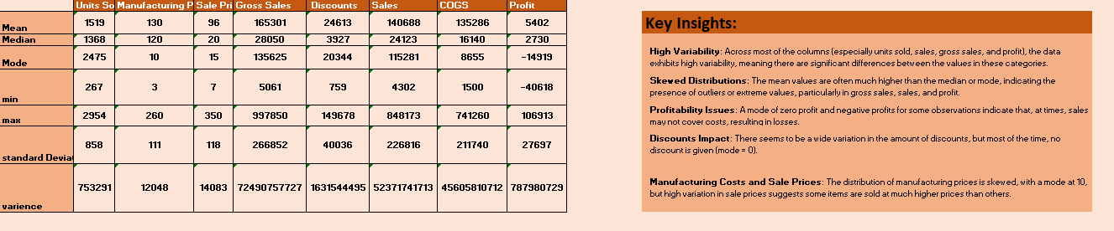
STATICAL ANALYSIS AND SUMMARY
Key Insights:
High Variability: Across most of the columns (especially units sold, sales, gross sales, and profit), the data exhibits high variability, meaning there are significant differences between the values in these categories.
Skewed Distributions: The mean values are often much higher than the median or mode, indicating the presence of outliers or extreme values, particularly in gross sales, sales, and profit.
Profitability Issues: A mode of zero profit and negative profits for some observations indicate that, at times, sales may not cover costs, resulting in losses.
Discounts Impact: There seems to be a wide variation in the amount of discounts, but most of the time, no discount is given (mode = 0).
Manufacturing Costs and Sale Prices: The distribution of manufacturing prices is skewed, with a mode at 10, but high variation in sale prices suggests some items are sold at much higher prices than others.
Statistical Observations:
Cost of Goods Sold (COGS):
The total COGS ($1.01B) aligns closely with total sales ($1.18B), yielding a gross profit of approximately 14.2%, suggesting room for efficiency improvements.
Discount Analysis:
Discounts appear significant, as total discounts ($9.2M) contribute substantially to net profit erosion.
Correlation Analysis:
Sales and Profit:
A strong positive correlation between sales and profit indicates that higher sales directly contribute to profitability, but with varying efficiency by product and region.
Units Sold and Profit:
Moderate correlation suggests that profit margins are not directly proportional to the number of units sold, indicating the importance of focusing on high-margin products.

Slide 5

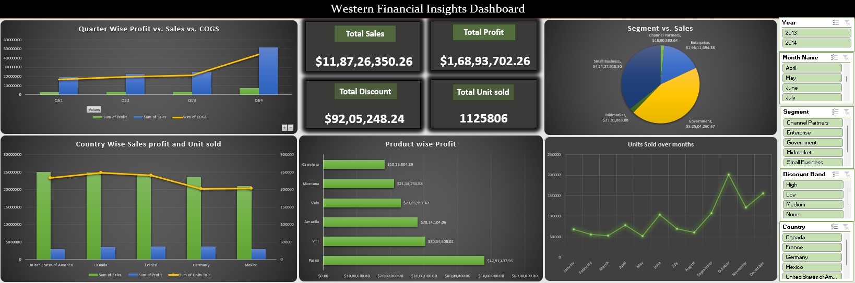
Graphical Analysis using Excel
1. Country-Wise Insights:
Sales and Profit Distribution:
The United States of America contributes the highest sales ($25.03M) but has a moderate profit margin compared to other countries.
Canada outperforms other countries in profit generation ($3.53M), showing an efficient cost-to-revenue ratio.
France and Germany have similar sales figures (~$24M), but France has a slightly higher profit ($3.78M vs. $3.68M).
Units Sold:
Highest units sold in Canada (247,428.5) indicates better penetration or consumer demand.
Mexico has the lowest sales and units sold among these countries, suggesting room for growth or inefficiencies.
Product Insights:
Top-Performing Products:
Paseo leads in sales ($33.01M) and profit ($4.8M), making it the most profitable product.
Amarilla and VTT also show significant profitability with $2.81M and $3.03M respectively.
Low-Performing Products:
Carretera generates the least profit ($1.8M), despite moderate sales ($13.81M), indicating potential cost inefficiencies.
Segment Wise Insights:
Revenue and Cost Efficiency:
The Government segment generates the highest sales ($52.5M) but with high associated costs, indicating lower efficiency.
Enterprise and Small Business segments have better cost-to-revenue ratios opportunities in Segments
Midmarket shows the smallest contribution ($2.38M) but has potential for growth with targeted marketing or product adaptation.
Monthly Insights:
Seasonality in Sales:
October leads in sales ($21.67M) and profits ($3.43M), indicating a peak season, possibly due to holidays or fiscal cycles.
February and March show lower sales, suggesting these months might need promotional efforts.
Profit Volatility:
Profits peak in October but drop significantly in January, February, and March.

Slide 6
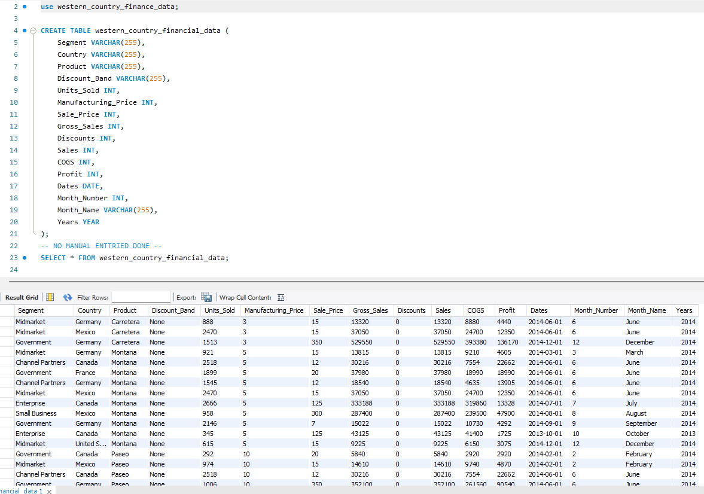
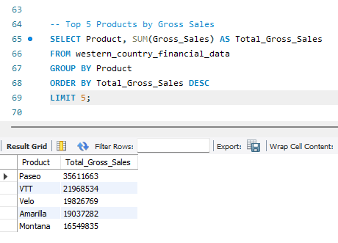
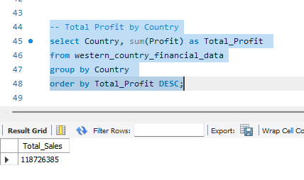
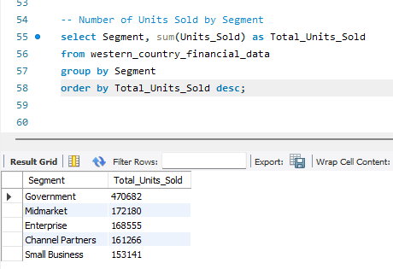
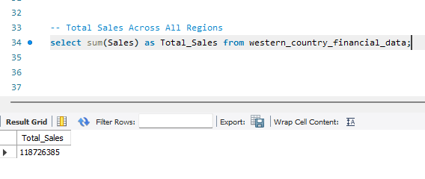
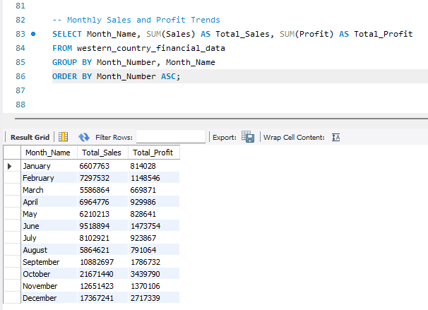
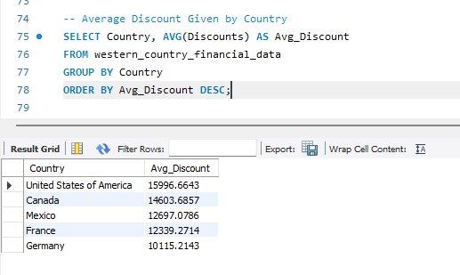
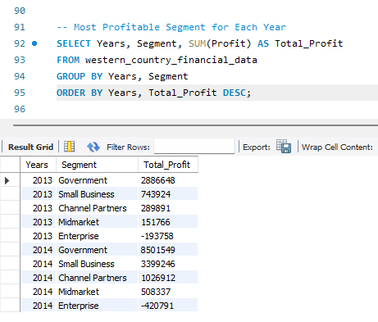
SQL Data Import and Queries

Slide 7
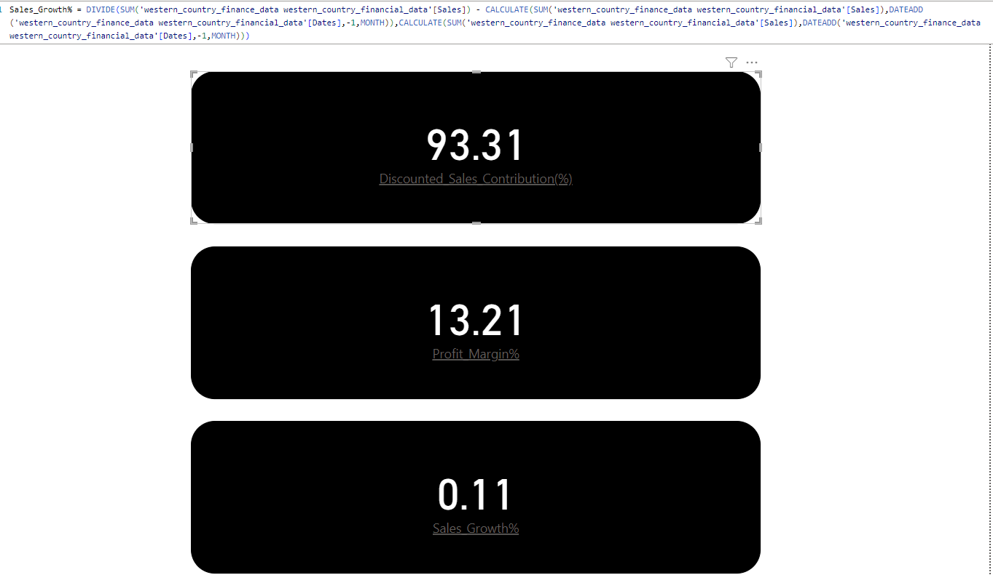
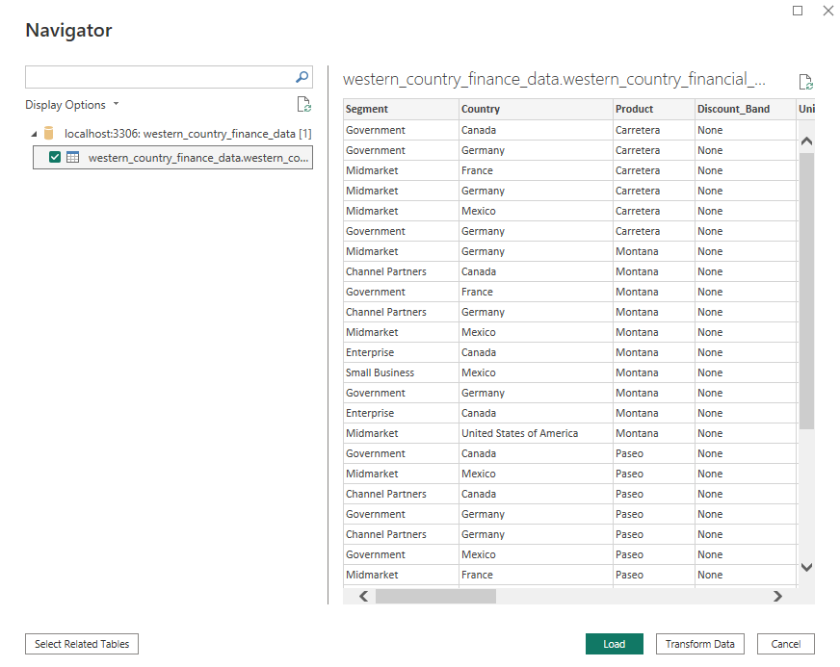
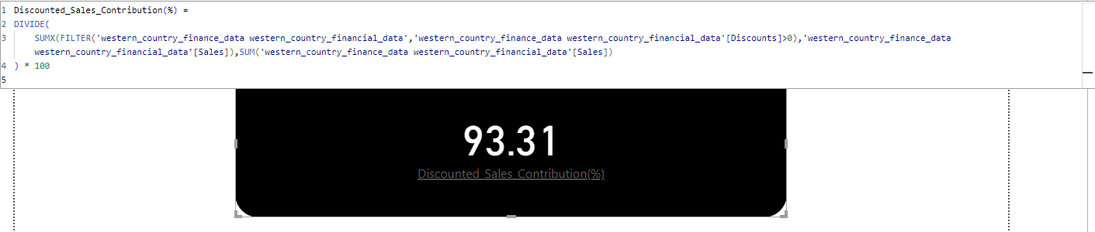
Power BI Database Import & measures

Slide 8
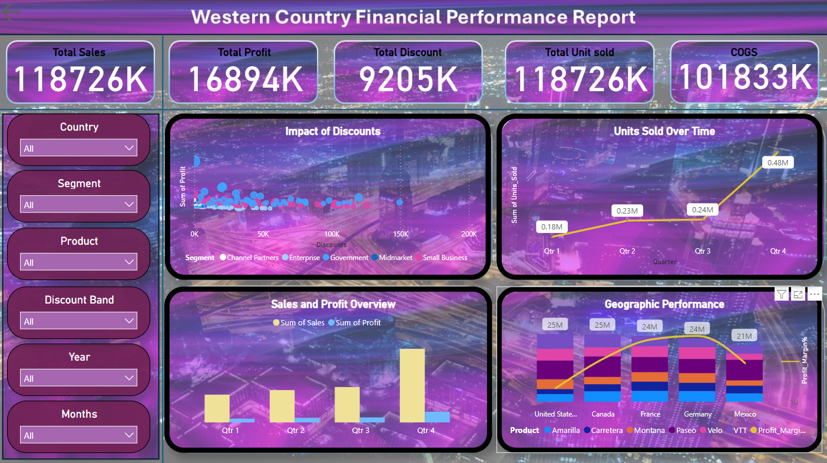
Power BI Visualization and Dashboard
The dashboard provides a comprehensive view of financial performance with a focus on sales, profit, and geographical trends. Notable highlights:
Q4 is a critical period for sales and profit.
Discounts play a significant role in driving sales across all segments.
The US and Canada are top contributors to sales, but there is potential for growth in markets like Mexico.
Recommendations:
Focus on High-Performing Quarters:
Prepare for Q4 with adequate inventory and marketing efforts to maximize revenue and profit.
Optimize Discount Strategies:
Evaluate discounts in segments like Enterprise and Small Business to ensure profitability is not compromised.
Expand Geographic Reach:
Focus on countries with lower sales like Mexico, while maintaining strongholds in the US and Canada.
Profit Margins:
Investigate ways to improve COGS and profit margins, especially in countries with lower efficiency.

Slide 9
Key Insights and Answers to Business Questions
4. Country-wise Sales (Top 5):
United States: $25,029,830
Canada: $24,887,650
France: $24,354,170
Germany: $23,505,340
Mexico: $20,949,350
5. Profit and Sales by Quarter:
Q1: $19,492,152 (Sales), $2,632,443 (Profit)
Q2: $22,693,880 (Sales), $3,232,378 (Profit)
Q3: $24,850,240 (Sales), $3,501,667 (Profit)
Q4: $51,690,078 (Sales), $7,527,214 (Profit)
6. Yearly Profit:
2014: $13,015,238
2013: $3,878,465
10. Units Sold Year-over-Year:
2013: 264,674 units
2014: 861,132 units
11 . Segment-wise Product Sales (Sample):
Government: Paseo ($14,882,230), Amarilla ($9,942,899), etc.
Small Business: Paseo ($11,498,810), Montana ($6,674,939), etc.
12. Segment-wise Product-wise Profit (Sample):
Government: Paseo ($3,057,291), VTT ($1,840,654), etc.
Small Business: Paseo ($1,231,310), Montana ($743,314), etc.
1. Product-wise Sales (Top 5):
Paseo: $33,011,140
VTT: $20,511,920
Velo: $18,250,060
Amarilla: $17,747,120
Montana: $15,390,800
2. Segment-wise Profit:
Government: $11,388,170
Small Business: $4,143,168
Channel Partners: $1,316,803
Midmarket: $660,103
Enterprise: -$614,546 (loss)
3. Yearly Sales:
2014: $92,311,095
2013: $26,415,256
7. Top 2 Countries by Sales:
United States: $25,029,830
Canada: $24,887,650
8. Bottom 3 Products by Sales:
Amarilla: $17,747,120
Montana: $15,390,800
Carretera: $13,815,310
9. Product-wise Discount (Top 5):
Paseo: $2,600,518
Velo: $1,576,709
VTT: $1,456,612
Amarilla: $1,290,163
Montana: $1,159,033

Slide 10
Conclusion & Inferences
1. Product Performance
Top Products: Paseo, VTT, and Velo are the top-performing products, with Paseo leading by a significant margin. These products should be the focus of marketing campaigns to drive further sales.
Low Performers: Carretera is the least-selling product, followed by Montana and Amarilla. These may require review for pricing, promotion, or customer demand.
2. Segment Analysis
Most Profitable Segment: The Government segment is the most profitable, contributing $11.4M to total profits. Investments and sales efforts should prioritize this segment.
Least Profitable Segment: The Enterprise segment incurs a loss of $614K, suggesting inefficiencies or high operational costs. Reassessing strategies in this segment is recommended.
3. Yearly Trends
Yearly Growth:
Sales grew from $26.4M in 2013 to $92.3M in 2014, reflecting a 249% increase.
Profit also increased substantially from $3.9M in 2013 to $13M in 2014.
This indicates robust growth, likely due to improved sales strategies or increased market demand.
4. Quarterly Insights
Q4 Dominates: Sales ($51.7M) and profits ($7.5M) peak in Q4, indicating strong seasonality. Businesses should maximize inventory and marketing efforts in Q4.
5. Geographic Insights
Top Countries: The United States ($25M) and Canada ($24.9M) are the highest contributors to sales. These markets are essential for maintaining revenue.
Diversify Efforts: Countries outside the top 5 (e.g., smaller markets) show potential for growth if targeted with tailored strategies.
6. Discounts and Profitability
High Discounts: Products like Paseo and Velo receive significant discounts but still rank high in sales. This suggests that competitive pricing drives their demand.
A detailed review is required to balance discounts and profit margins for sustained profitability.
7. Units Sold Year-over-Year
Units sold increased from 264K (2013) to 861K (2014), a significant rise. This reflects increased market penetration or demand.
8. Segment-wise Product Insights
In the Government segment, Paseo and Amarilla dominate sales and profitability.
In the Small Business segment, Paseo and Montana perform exceptionally well.

Slide 11
Recommendations
1.Enhance Focus on High-Performing Products and Segments:
Prioritize Paseo, VTT, and the Government segment for future strategies.
2.Address Underperformance:
Investigate reasons behind the losses in the Enterprise segment and low sales of Carretera.
3.Leverage Seasonal Trends:
Optimize operations and marketing for Q4, which has the highest sales and profits.
4.Diversify Geographic Presence:
Expand efforts in mid-tier countries to reduce dependency on top markets like the US and Canada.
5.Optimize Discount Strategies:
Analyse discount effectiveness to balance volume and profitability.

Slide 12
links
Power BI File :
https://drive.google.com/file/d/1tyjSlKjBhUG4I7woVvVsliEc0JKGufu_/view?usp=sharing
SQL File:
https://drive.google.com/file/d/1wGsjKg_6A2thlDuJ-rR8xr1IXqx5BqvU/view?usp=sharing
Excel File :
https://docs.google.com/spreadsheets/d/1CwExiZL5o7nGjOKpRe6Al3xDPaammWK0/edit?usp=sharing&ouid=103918262432186967334&rtpof=true&sd=true

Slide 13
THANK YOU…

